Slide 1
PLACEMENT TRAINING PROJECT REVIEW
SRI SHAKTHI INSTITUTE OF ENGINEERING AND TECHNOLOGY
COIMBATORE – 641 062
SMART TAP WATER MONITORING SYSTEM
Mithun Krishnan U- 714019105019
Dinesh Pon Eshwaran I-
714019105007
Nitheeshwar RS-
714019105024

Slide 2
CONTEXT
OBJECTIVES
ABSTRACT
INTRODUCTION
LITERATURE SURVEY
NEEDS
PROPOSED SYSTEM
SOFTWARE
HARDWARE
ADVANTAGES
CONCLUSION
REFERENCE

Slide 3
OBJECTIVES
To make the work of the corporation workers easy, by monitoring the tap water leaks and making them take necessary actions accordingly from any part of the world

Slide 4
ABSTRACT
Monitoring the tap water’s moisture continuously and uploading in IoT(Thing speak) and automatically closing the tap in case of open condition of tap, when there is no container placed beneath. Making use of the available resources the project is designed.

Slide 5
INTRODUCTION
Our project makes use of the NodeMCU with ESP8266 module developed by Amica. The presence of ESP8266 makes the MCU connect to IoT. The NodeMCU with this WiFi makes the easiness of monitoring. The moisture sensor which senses the leak and the servo which controls the mechanical movement of the tap stopper.

Slide 6
LITERATURE SURVEY
SNO | PAPER | AUTHORE NAME AND DATE | CONCEPT
1 | Smart water quality monitoring system | A. N. Prasad, K. A. Mamun , F. R. Islam, H. Haqva 2015 2nd Asia-Pacific World Congress on Computer Science and Engineering (APWC on CSE) | Monitoring the quality of water using IoT.
2 | Smart Water Management Platform: IoT-Based Precision Irrigation for Agriculture | Carlos Kamienski, Juha-Pekka Soininen, Markus Taumberger, Ramide Dantas, Attilio ToscanoTullio , Salmon Cinotti, Rodrigo Filev Maia and André Torre Neto Published: 11 January 2019 | Ensuring the good quality of water for agriculture land and monitoring them using IoT.
3 | Cloud-based smart water quality monitoring system using IoT sensors and machine learning | Bineet Kumar Jha, . and Sivasankari, G.G. and Venugopal, K.R. (2020) | Parameters such as conductivity, pH, nitrate, biochemical oxygen demand, fecal coliform are significant parameters in deciding the quality of water. So monitoring them prior to supply by IoT and ML.

Slide 7
NEEDS
Water is the most precious elixir of life.
After oxygen water decides the life, so preserving them is a great need.
Wasting them may lead our future to live a drought life.
Always “prevention is better than cure” , so this project by us can help some part of it and save the water to an extent.

Slide 8
PROPOSED SYSTEM
The project works as when there is no use of tap the moisture sensor continuously monitors the tap and sends it IoT. If the moisture sensor reads a constant value above the threshold limit of leak. The servo motor turns and makes the tap off. If the people used it forget to turn it off after use. In case the water leaks persists the readings from IoT is taken and analysed for the leakage repairing

Slide 9
SOFTWARE
Software Used :-
Arduino IDE
Thing Speak IOT
CODE
#include "ThingSpeak.h"
#include <ESP8266WiFi.h>
#include<Servo.h>
Servo servo;
const int sensor_pin=A0;
char ssid[] = "Redmi"; // your network SSID (name)

Slide 10
SOFTWARE
char pass[] = "mithun@2002"; // your network password
int keyIndex = 0; // your network key Index number (needed only for WEP)
WiFiClient client;
unsigned long myChannelNumber = 1662686;
const char * myWriteAPIKey = "OXAX03XOL2Z4TBVE";
void setup() {
servo.attach(2);//D4
//
// delay(2000);
Serial.begin(115200); // Initialize serial
WiFi.mode(WIFI_STA);
ThingSpeak.begin(client); // Initialize ThingSpeak
}

Slide 11
SOFTWARE
void loop() {
servo.write(0);
// Connect or reconnect to WiFi
if(WiFi.status() != WL_CONNECTED){
Serial.print("Attempting to connect to SSID: ");
Serial.println(ssid);
while(WiFi.status() != WL_CONNECTED){
WiFi.begin(ssid, pass); // Connect to WPA/WPA2 network. Change this line if using open or WEP network
Serial.print(".");
delay(5000);
}
Serial.println

Slide 12
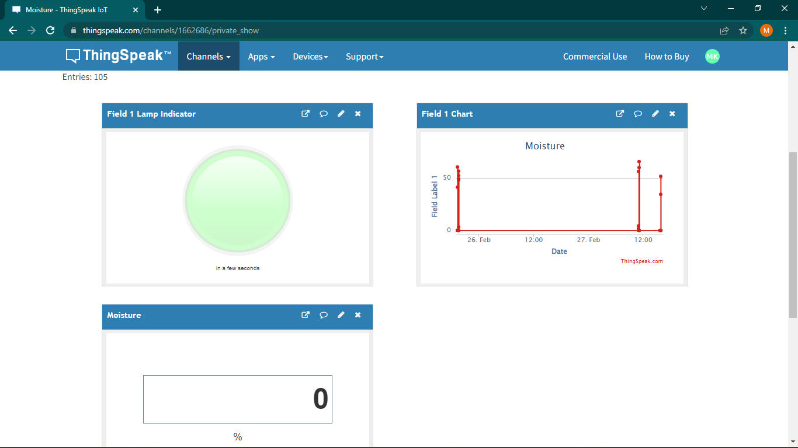
SOFTWARE

Slide 13
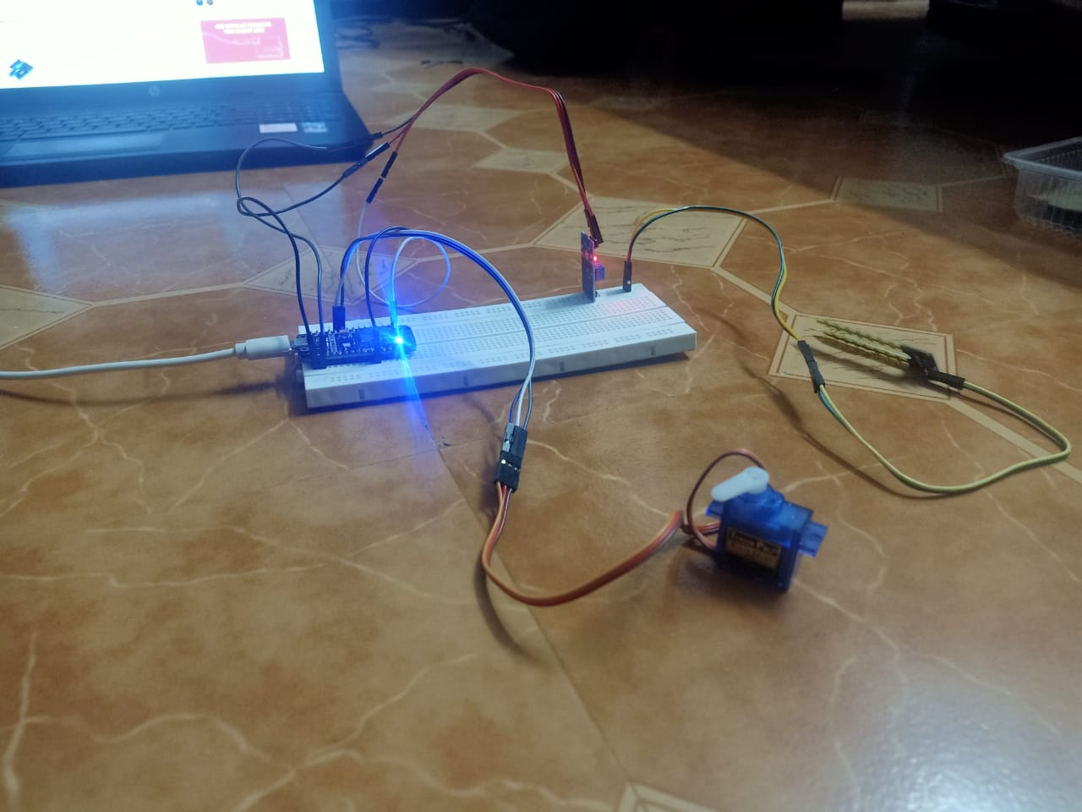
HARDWARE
Resistance Based Moisture Sensor
NodeMCU
Servo motor
Jumper Wires

Slide 14
ADVANTAGES
No need for frequent transport for checking the leakage.
No need to depend on any person to check the water.
Easy to use and can be monitored from anywhere.
Can also able to include multiple fields.
Can be made a public channel.

Slide 15
CONCLUSION
Making sure the taps are proper and preserve the water for future use in a small scale level, as efficient as we can.
Therefore no taps shall be found leaked and ensuring the complete replacement of them.

Slide 16
REFERENCE
International Journal of Networks and Communications p-ISSN: 2168-4936 e-ISSN: 2168-4944
2017; 7(1): 1-16 doi:10.5923/j.ijnc.20170701.01
Misiunas, D., Lambert, M., Simpson, A., Olsson, G. “Burst detection and location in water distribution networks,” Water Science and Technology: Water Supply, 5(3–4), 71–80. (2005).
Bowling, Michael. "Leakage testing method for a plate heat exchanger." U.S. Patent 6,062,068, issued May 16, 2000.

